Slide 1
Lecture No. 40
At the end of this lecture, students will be able to:
Explain the structure property relationship of Polymers
Discuss the advantages and applications of biodegradable polymers

Slide 2
Structure-Property Relationships
The structure of a polymer has major influence on some of the properties of polymers
The properties such as crystallinity, tensile strength, elastic nature and chemical resistance are largely dependent on the structure of the polymer

Slide 3
Structure-Property Relationships
Tensile strength:
Density, melt viscosity and tensile strength are a few important mechanical properties of a polymer
These are highly influenced by molecular weight of polymers
Tensile strength is increases with molecular mass of the polymer up to 20000. Beyond that the increase is negligible

Slide 4
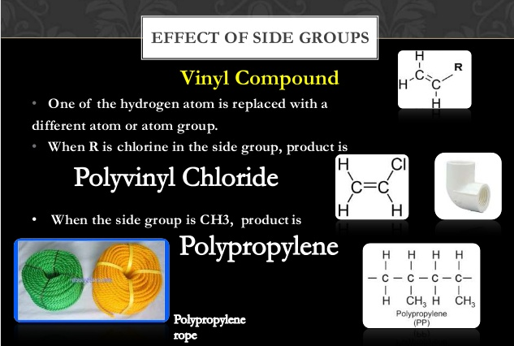

Slide 5
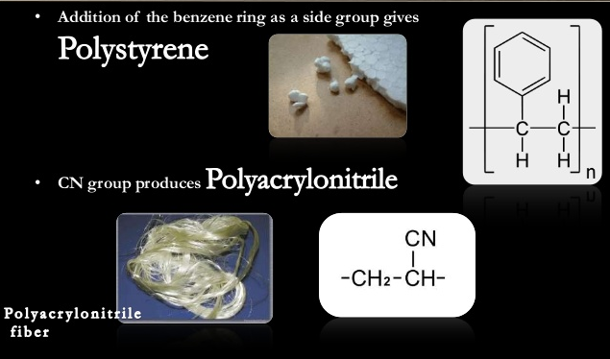
Tensile strength

Slide 6
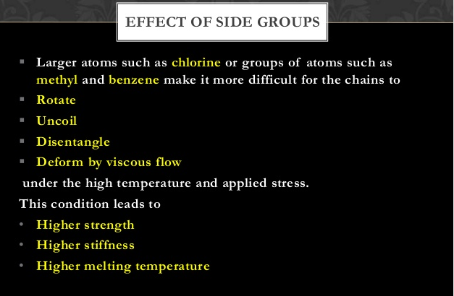
Tensile strength

Slide 7
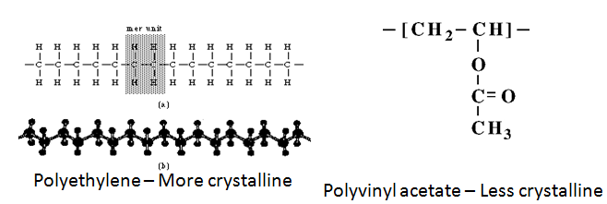
Structure-Property Relationships (Crystallinity)
Crystallinity:
The degree of crystallinity of polymer depends on its structure and stereo regularity..
Structure of polymers: Linear polymers without bulky groups &hydrogen bonding are more crystalline than branched & polymers have bulky groups.
Ex: HDPE High density polyethylene has high degree Crystallinity than polyvinylactetate

Slide 8
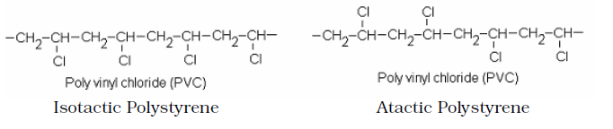
Structure-Property Relationships (Crystallinity)
Stereo regularity of the polymer: Isotactic polymers are more crystalline
than atactic polymers
Ex; Isotactic polyvinyl chloride is more crystalline than Atactic polyvinyl
Chloride (random arrangements of groups)
It also depends on polar groups & hydrogen bonding
Polymers having polar groups & hydrogen bonding have high degree of Crystallinity.

Slide 9
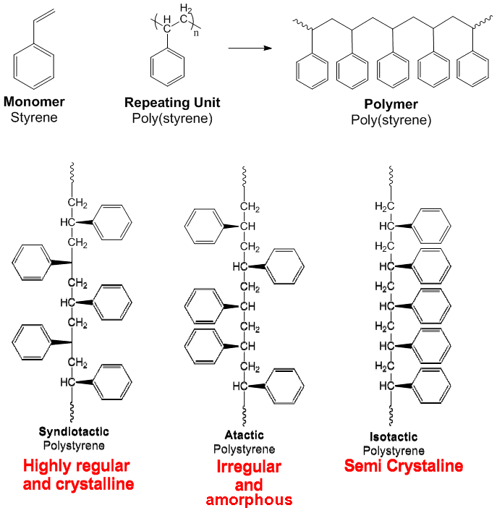
Structure-Property Relationships (Crystallinity)
Stereo regularity of the polymer:
Isotactic polymers are more crystalline than atactic polymers

Slide 10
Structure-Property Relationships
Elasticity: A polymers should have good elastic property
The elasticity is due to uncoiling & recoiling of the molecular chain on the application of force
It should not break on prolonged stretching
The elasticity of a polymer can be improved
By introducing cross linkages at suitable positions
Avoiding side group such as aromatic and cyclic structures
By introducing more non polar groups on the chain so that the chain does not separate on stretching
By introducing internal plasticizers during polymerization

Slide 11
Chemical Resistance
Chemical Resistance: Polymer should have more resistivity to chemical attack and should not become soft, swelling, or loosing its strength
The chemical resistivity of a polymer depends mainly on presence of polar & non polar groups in the polymer chain
Presence of polar groups such as –OH, -COOH, are less resistance to chemical attack
But non-polar groups such as –CH3, -C6H5, NHCO, etc., more resistance to chemical attack
Ex: PVC, ABS, PS, etc., have high resistance towards chemicals

Slide 12
Biodegradable Polymers
Polymers comprised of monomers linked to one another through functional groups and have unstable links in the backbone
Broken down into biologically acceptable molecules that are metabolized and removed from the body via normal metabolic pathways
Eg: collagen, poly glycolic acid, starch, chitosan, etc.,

Slide 13
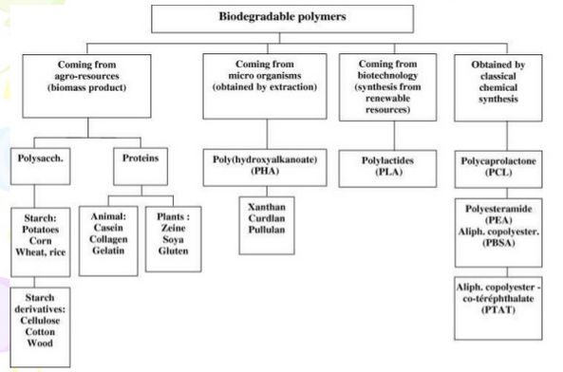
Classification of biodegradable polymers

Slide 14
Polymer degradation
Polymer degradation is a change in the properties – tensile strength, colour, shape, etc of a polymer or polymer based product under the influence of one or more environmental factors such as heat, light or chemicals
The term 'biodegradation' is limited to the description of chemical processes (chemical changes that alter either the molecular weight or solubility of the polymer)
Bioerosion may be restricted to refer to physical processes that result in weight loss of a polymer device
The bioerosion of polymers is basically of two types :-
1) Bulk erosion 2) Surface erosion

Slide 15
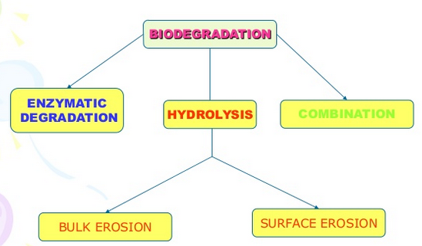
Mechanism Of Biodegradable Polymers

Slide 16
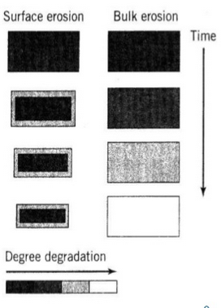
Types of Bioerosion
1) Bulk erosion
Degradation takes place throughout the whole of the sample
Ingress of water is faster than the rate of degradation
Eg : Polylactic acid (PLA) Polyglycolic acid (PGA)
2) Surface erosion
Sample is eroded from the surface
Mass loss is faster than the ingress of water into the bulk
Eg:Polyanhydrides , polyorthoesters

Slide 17
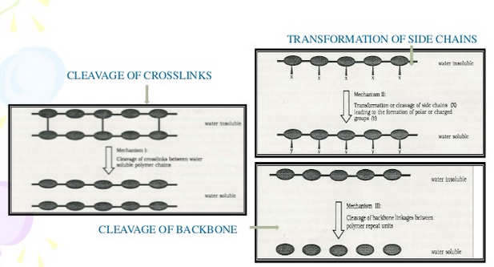
Enzymatic or Chemical Degradation
Chemical or enzymatic degradation – It is mediated by water, enzymes, microorganisms

Slide 18
Classification of biodegradable polymers based on the source
Synthetic biodegradable polymers:
Example:
Aliphatic poly(esters)
Polyanhydrides
Polyphosphazenes
Polyaminoacids
Poly orthoesters etc.,
Natural biodegradable polymers:
Example:
Albumin
Collagen
Dextran
Gelatin
Pectin
starch etc.

Slide 19
Biodegradable Polymers
Acetal:
Hemiacetal:
Ether
Nitrile
Phosphonate
Polycyanocrylate
OH
OH
C
O
OH
C
OH
OH
C
H₂O
C
OH
C
+
H₂O
OH
C
C
OH
C
C
C==O
OH
OH
H

Slide 20
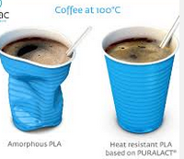
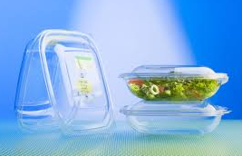
Uses of Polylactic Acids:
Mulch film made of PLA-blend PLA cups bio-flex
Biodegradable PLA cups in use at an eatery
Due to PLAs relatively low glass transition temperature, PLA cups cannot hold hot liquids
However, much research is devoted to developing a heat resistant PLA

Slide 21
Advantages Of Biodegradable Polymers
Localized delivery of drug
Sustained delivery of drug
Stabilization of drug
Decrease in dosing frequency
Reduce side effects
Improved patient compliance
Controllable degradation rate

Slide 22
Applications Of Biodegradable Polymers
Polymer system for gene therapy
Biodegradable polymer for ocular, tissue engineering, vascular, orthopedic, skin adhesive & surgical glues
Bio degradable drug system for therapeutic agents such as anti tumor, antipsychotic agent, anti-inflammatory agent
Polymeric materials are used in and on soil to improve aeration, and promote plant growth and health
Many biomaterials, especially heart valve replacements and blood vessels, are made of polymers like Dacron, Teflon and polyurethane

Slide 23
Summary
Structure property relationship of Polymers:
Tensile strength is increases with molecular mass
Linear polymers without bulky groups &hydrogen bonding are more crystalline than branched & polymers have bulky groups
Presence of polar groups such as –OH, -COOH, are less resistance to chemical attack
But non-polar groups such as –CH₃, -C₆H₅, NHCO, etc., more resistance to chemical attack
Biodegrable polymers: Polymers which can degraded biologicaly
Its advantages and application

